Slide 1
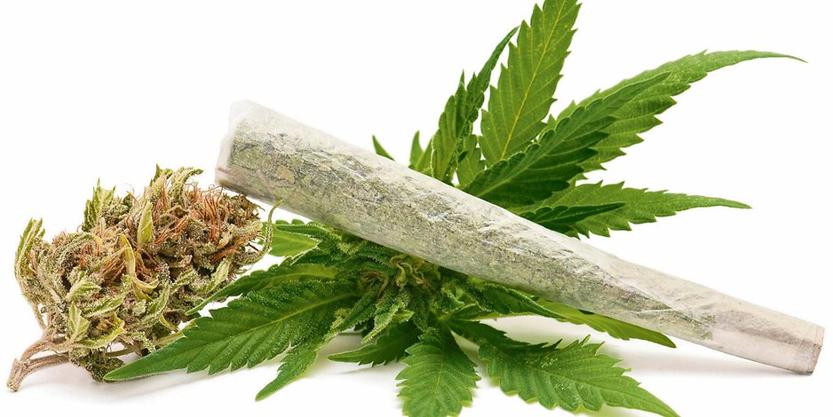
Medical Use of Marijuana: Truth in Evidence
Collective review
R3 Jutamas Srisung
Adviser : Col. Narongsak Jasadapatarakul

Slide 5
ประกาศราชวิทยาลัยจิตแพทย์แห่งประเทศไทย ที่12/2561
Notes:
-delta 9 Tetrahydrocannabinol

Slide 6
Introduction
The cannabis plant has been used for centuries by different ancient cultures as a remedy, also known as hemp or marijuana
The use of Cannabis indica for multiple medical conditions, including catalepsy, rabies, cholera, tetanus, infantile convulsions, and delirium tremens
Queen Victoria may have used marijuana to treat her dysmenorrhea
Medical Use of Marijuana: Truth in Evidence ; anesthesia & analgesia November 2015 • Volume 121 • Number 5
Notes:
Cannabis plant ถูกใช้มาเป็นเวลานาน ซึ่งใช้ในการรักษาในวัฒนธรรมที่แตกต่างในแต่ละพื้นที่

Slide 7
Introduction
The cannabinoid receptor family currently includes 2 cloned metabotropic receptors
- CB1 (found predominantly in the brain)
- CB2 (found primarily in the peripheral immune system and to a lesser degree in the CNS and microglia)
healthy brain tissue does not express CB2 receptors
Rather, CB2 receptors are upregulated in reactive microglial cells in the CNS in neuroinflammatory disorders
Medical Use of Marijuana: Truth in Evidence ; anesthesia & analgesia November 2015 • Volume 121 • Number 5
Notes:
-Both cannabinoid receptors belong to the G-protein–coupled receptor superfamily coupled to Gi/o proteins, Gq/11.
- 2 cannabinoid receptors, the endocannabinoid signaling system in the CNS includes 2 endogenous ligands (anandamide and 2-arachidonoglycerol), 2 enzymes responsible for synthesizing endogenous ligands (1,2-diacylglycerol lipase and phospholipase A)

Slide 8
Introduction
Endocannabinoid system : cannabidiol, cannabinol and tetrahydrocannabinol → fit with receptor in a lock and key system
These endocannabinoids activate presynaptic CB1 receptors, inhibiting neurotransmitter release from the presynaptic neurons
Inhibition of transmitter release via at presynaptic mechanism
Medical Use of Marijuana: Truth in Evidence ; anesthesia & analgesia November 2015 • Volume 121 • Number 5
Notes:
- Tetrahydrocannabinol and several cannabinoids (chemical composition)
its activation leads to inhibition of transmitter release. inhibition of neurotransmission via a presynaptic mechanism.

Slide 9
Notes:
-Endocannabinoid system
-rp impact physiological process eg pain modulation , memory and appetite plus anti inflammatory effect and immune system
-CB1 primary in brain CNS , CB2 in pheripheral organ associated c immune system
Cannabidiol doesnot fit CB1 CB2 but have indirect effect
Both CB(1) and CB(2) couple primarily to inhibitory G proteins and are subject to the same pharmacological influences as other GPCRs. → ts activation leads to inhibition of transmitter release.

Slide 10
Tetrahydrocannabinol and its metabolites
THC is lipid containing of the plasma → distribute and absorb by fatty tissue
Isomer of Tetrahydrocannabinol
- Delta 9 THC and Delta 8 THC
Delta 9 THC is the most psychological effect in cannabis use
Tissue elimination half-life of THC is approximately 7 days , total elimination up to 30 days.
Anesthetic Consideration in a Cannabis Addict; Journal of the College of Physicians and Surgeons Pakistan 2015, Vol. 25(Special Supplement 1): S2-S3
Notes:
THC = teteahydrocannabinol

Slide 11
Tetrahydrocannabinol and its metabolites
THC is an agonist to two major cannabinoid receptors (CB1 and CB2)
Agonists are of central physiological → direct biological effects modulating neurotransmitter systems
Synthetic cannabinoids :
- nabilone, dronabinol (withdrawn from the market)
- nabiximols (THC-CBD extracts).
Medical Use of Marijuana: Truth in Evidence ; anesthesia & analgesia November 2015 • Volume 121 • Number 5
Notes:
The best-characterized constituent is D9-tetrahydrocannabinol (THC),

Slide 12
Legal cannabis use country
Notes:
Decriminalize = ลดโทษ

Slide 13
Improving Medical Marijuana
Marijuana is currently classified as a schedule 1 substance in the United States, signifying “no accepted medicinal use.”
This places marijuana in the same category as heroin and lysergic acid diethylamide.
Despite the ongoing war on drugs, marijuana continues to be the most widely used illicit substance in the United States
Medical Use of Marijuana: Truth in Evidence ; anesthesia & analgesia November 2015 • Volume 121 • Number 5
Notes:
-This classification was motivated by politics, not science.

Slide 14
Improving Medical Marijuana
Twenty-three states currently have laws legalizing the medical use
4 states (Alaska, Colorado, Oregon, and Washington) and the District of Columbia have legalized marijuana for both medical and recreational use
Cannabis in Canada is legal for recreational and medical purposes. Medicinal use of cannabis was legalized nationwide in 2001 under conditions outlined in the Marihuana for Medical purposes Regulations
Medical Use of Marijuana: Truth in Evidence ; anesthesia & analgesia November 2015 • Volume 121 • Number 5
Notes:
Recreational = การพักผ่อนหย่อนใจ

Slide 15
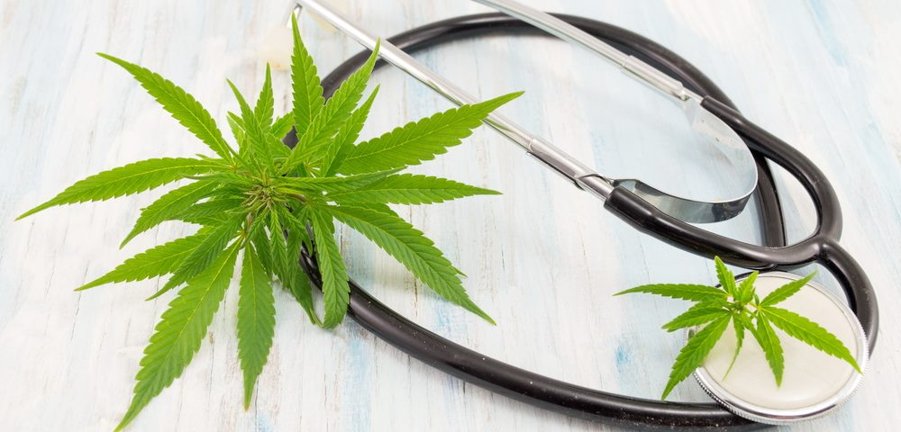
Improving Medical Marijuana
Anecdotal reports claim the efficacy of marijuana in medical conditions, including
- anorexia
- neuropathic pain
- spasticity
- posttraumatic stress disorder
- migraine
- glaucoma
- nausea and vomiting
Medical Use of Marijuana: Truth in Evidence ; anesthesia & analgesia November 2015 • Volume 121 • Number 5

Slide 16
Improving Medical Marijuana
Pharmaceuticals, Inc. Company, Marietta, GA was first licensed and approved in 1986 for the treatment of chemotherapy-induced nausea and vomiting.
The neurocircuitry involved in nausea and vomiting includes the area postrema, on floor of 4th ventricle → poor in CB1 receptor expression
Little evidence to understand the mechanism by which a CB1 agonist might affect postoperative nausea and vomiting (PONV).
Medical Use of Marijuana: Truth in Evidence ; anesthesia & analgesia November 2015 • Volume 121 • Number 5
Notes:
N/V (chemorecepter trigger zone) center medulla oblongata , locate in area postrema on the floor of 4th ventricle

Slide 17
The effects of 2 mg preoperative oral nabilone, a synthetic Δ9-THC and oral metoclopramide on PONV were compared in a prospective, double-blind study in patients undergoing total abdominal hysterectomy
The incidence of PONV was found to be similar between the 2 groups

Slide 18
systematic review of 30 randomized controlled trials, the effectiveness of cannabinoids
- oral nabilone, oral dronabinol, IM levonantradol in chemotherapy-induced nausea and vomiting was evaluated in 1366 patients
Cannabinoids were found to be more effective antiemetics than prochlorperazine, metoclopramide, chlorpromazine
However, no comparisons of cannabinoids with 5-HT3 receptor antagonists
Notes:
, thiethylperazine, haloperidol, domperidone, or alizapride

Slide 19
Patients given cannabinoids were more likely to withdraw because of side effects → paranoid, hallucinations, dysphoria or depression
Authors analyzed the incidence of complete control of nausea or vomiting only in the first 24 hours → limitation
Notes:
authors analyzed the incidence of complete control of nausea or vomiting only in the first 24 hours,

Slide 20
Kleine Brueggeney et al. administered Δ9-THC IV 0.125 mg/kg with a maximum of 10 mg, a dose chosen to target a maximum effect.
potentially less than the clinically significant 25% relative risk reduction demonstrated by other drugs used for PONV prophylaxis
Psychotropic THC side effects were clinically relevant and mainly consisted of sedation and confusion
Notes:
-Evidence suggests that cannabinoids can prevent chemotherapy-induced nausea and vomiting
-Our hypothesis was that THC would reduce the relative risk of PONV by 25% compared with placebo.
-The use of tetrahydrocannabinol (THC) has also been suggested for the prevention of postoperative nausea and vomiting (PONV),
The primary outcome parameter was PONV during the first 24 hours after emergence.
Secondary outcome parameters included early and late nausea, emetic episodes and PONV, and side effects such as sedation or psychotropic alterations.
Because of an unacceptable side effect profile and uncertain antiemetic effects, IV THC administered at the end of surgery before emergence from anesthesia cannot be recommended for the prevention of PONV in high-risk patients.

Slide 21
Because of an unacceptable side effect, , IV THC administered at the end of surgery cannot be recommended for the prevention of PONV in high-risk patients.
Notes:
Moreover, Δ9-THC was associated with substantial psychotropic side effects, prompting early termination of the study.

Slide 22
In 1992, the Food and Drug Administration approved dronabinol as an appetite stimulant for the treatment of acquired immune deficiency syndrome (AIDS)-related weight loss.
evidence for the efficacy and safety is lacking
Cannabinoids for medical use; JAMA June 23/30 2015

Slide 23
Improving Medical Marijuana
The pharmacokinetics and bioavailability of Δ9THC vary considerably in humans
- depend on whether inhaled, injected, or swallowed.
Peak plasma levels of Δ9-THC after smoking marijuana occur more rapidly, and the bioavailability is substantially greater (18%–50% vs 6%–20%).
The size and execution of the study significantly more challenging.
Cannabinoids for medical use; JAMA June 23/30 2015
Notes:
Execution = การกระทำ

Slide 24
Cannabis and pain management

Slide 25
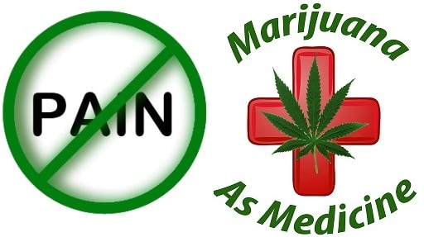
Introduction: medical cannabis and pain
Physicians, especially anesthesiologists involved in the management of pain and the side effects of analgesics, will be queried by our patients whether marijuana is right for them.
Medical cannabis: considerations for the anesthesiologist and pain physician; Can J Anesth/J Can Anesth (2016) 63:608–624

Slide 26
Introduction: medical cannabis and pain
The best-characterized constituent is D9-tetrahydrocannabinol (THC), the principal psychoactive component of cannabis
Cannabinoids produce their effects through the activation of two distinct G-protein-coupled receptors : cannabinoid CB1 and CB2
- CB1 receptor : at high levels in the central nervous system (CNS)
and along pain pathways
- CB2 receptor : outside the CNS, where expressed in peripheral
tissues with immune functions
Medical cannabis: considerations for the anesthesiologist and pain physician; Can J Anesth/J Can Anesth (2016) 63:608–624
Notes:
-Sativa, Indica, and Ruderalis are three separate species or subspecies of Cannabis sativa. Cannabis contains 545 chemical compounds

Slide 27
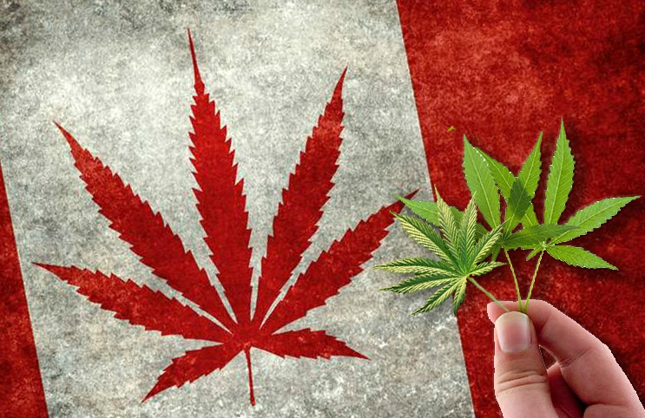
Introduction: medical cannabis and pain
Major pharmacological discoveries of the 1990s sparked interest in the possible medical uses for cannabinoids as potential analgesics ; treating various chronic pain conditions.
Marijuana available on the Canadian market (companies, plants and drugs, mode of deliveries)
Medical cannabis: considerations for the anesthesiologist and pain physician; Can J Anesth/J Can Anesth (2016) 63:608–624
Notes:
- new Canadian regulations on medical cannabis and the current provincial licensing authorities regulations in Canada

Slide 28
Cannabinoids may play an important role in mediating a variety of neurophysiological processes including nociception
Medical cannabis: considerations for the anesthesiologist and pain physician; Can J Anesth/J Can Anesth (2016) 63:608–624
Notes:
พบว่า cannabinoid อาจจะเป็น role ที่สำคัญเกี่ยวกับ neurophysiological process ที่ เกี่ยวข้องกับ nociception

Slide 29
Epileptic patient, to use marijuana to treat his severe epilepsy
The regulations state that patients may not possess more than one month’s amount of marijuana, or a maximum of 150 g, at one time
Notes:
Possess = ครอบครอง
2001, the Canadian government enacted regulations for access to dried marijuana for medical purposes through the Marihuana Medical Access Regulations (MMAR).

Slide 30
Update on clinical studies on cannabis and pain
Acute pain
Chronic non-cancer-related pain
Cancer-related pain

Slide 31
Acute pain
Acute pain study
- including marijuana, cannabis extracts, THC, nabilone, dronabinol, and levonantradol.
- In addition, in some cases, administration of cannabinoids, especially in high doses, is associated with increased pain.
Medical cannabis: considerations for the anesthesiologist and pain physician; Can J Anesth/J Can Anesth (2016) 63:608–624

Slide 32
Based on studies conducted in the post operative setting in human volunteers (13 studies) between 1977 and 2008
Cannabinoid agonists may cause the release of endogenous opioids function interplay between the endocannabinoid and opioid systems in the modulation of analgesic responses
Current Molecular Pharmacology, 2009, Vol. 2, No. 1
Notes:
Cannabinoid จะปล่อย endogenous opioid ซึ่งจะมีผล interaction ระหว่าง endocannabinoid and opioid system
mostly, in the epidermis and dermis
Nociceptor divided in 2 gr : unmyelinated C fiber and myelinated A delta fiber

Slide 33
Anatomical interaction between cannabinoid and opioid system
These cannabinoids are not very effective in alleviating acute pain
The interaction between the cannabinoid and the opioid system needs to be investigated further at the peripheral level.
Current Molecular Pharmacology, 2009, Vol. 2, No. 1
Notes:
-In addition, in some cases, administration of cannabinoids, especially in high doses, is associated with increased pain
- Alleviate = บรรเทา

Slide 34
Prospective, randomized study published in 2013 was carried out
in 73 patients undergoing elective operations
Postoperative analgesia in Jamaican cannabis users (n = 42) compared to non-users (n = 31).
Notes:
- Study in America

Slide 35
Cannabis users required signiﬁcantly more opioid rescue analgesia and had higher pain scores during the immediate postoperative period than non-users
female cannabis users required signiﬁcantly more analgesia than male users.
Further research is needed to elucidate the precise mechanism by which this occurs.
Notes:
-cross tolerance to opioids that develops in animals that are treated with THC or similar cannabis compounds
- Extrapolating this information to patients would suggest that a person recently exposed to cannabis may not be able to obtain the same pain
relief from an opioid after a painful episode compared to a cannabis-naive patient

Slide 36
Update on clinical studies on cannabis and pain
Acute pain
Chronic non-cancer-related pain
Cancer-related pain

Slide 37
Chronic non-cancer-related pain
Up to 2010, a total of 18 trials were reported in a systematic review
British Journal of Clinical Pharmacology © 2011 The British Pharmacological Society

Slide 38
13 of the trials focused on neuropathic pain
5 trials on other types of pain.
Cannabinoids studied included smoked cannabis, oromucosal extracts of cannabis based medicine, nabilone, dronabinol and a novel THC analogue
Chronic non-cancer pain included neuropathic pain, ﬁbromyalgia, rheumatoid arthritis and mixed chronic pain
Cannabinoids for treatment of chronic non-cancer pain; a systematic review of randomized trials
British Journal of Clinical Pharmacology © 2011 The British Pharmacological Society
Notes:
- Patients with depression had higher baseline pain scores and were also more likely to respond favorably to intervention, regardless of whether it was nabiximols or placebo administration

Slide 39
Cannabinoids are, on the whole, effective for treating chronic pain
All most all study showed that cannabinoids were effective in alleviating pain, especially neuropathic pain
Several trials reported signiﬁcant improvements in sleep, and there were no serious adverse events reported
Cannabinoids for treatment of chronic non-cancer pain; a systematic review of randomized trials
British Journal of Clinical Pharmacology © 2011 The British Pharmacological Society

Slide 40
Investigators postulated that cannabinoids and opioids act on the same pathways
Synergy in analgesic effects between opioids and cannabinoids has been demonstrated in animal models.
Antinociceptive effects of morphine maybe enhance by delta-9-tetrahydrocannabinol
Notes:
Cannabinoid inhibit metabolism of drug that slow GI motility , slow absorption of oral drug

Slide 41
Cannabis augment the analgesic effects of opioid
The vaporized cannabis augmented the analgesic effects of opioids without signiﬁcantly altering plasma opioid levels
RCT in chronic pain found that oral dronabinol (delta 9 THC) decrease pain significantly
This combination may allow opioid treatment at lower doses with fewer side effects.
Notes:
Study in pt take stable dose of mo or oxycodone → inhale vaporized cannabis 5 days can reduce pain significant

Slide 42
The mechanism of augmentation is not explained by elevation of plasma opioid or inhibition of opioid mechanism
Need more study of the synergistic interaction between cannabinoids and opioids.

Slide 43
Cannabinoids were effective in relieving pain in patients with musculoskeletal disorders, ﬁbromyalgia
Transient adverse effects or mild to moderate and most commonly consisted of sedation, dizziness, dry mouth, nausea
Notes:
-there were no differences in secondary safety assessments including pulmonary and neurocognitive function and standard hematology, biochemistry, renal, liver, and endocrine function

Slide 44
Update on clinical studies on cannabis and pain
Acute pain
Chronic non-cancer-related pain
Cancer-related pain

Slide 45
Cancer-related pain
In 177 patients with cancer-related pain who experienced inadequate analgesia despite chronic opioid dosing
Journal of Pain and Symptom Management Vol. 39 No. 2 February 2010

Slide 46
Compared the efﬁcacy of THC-CBD with placebo in regard to relieving the pain of patients with advanced cancer
Mean pain score was signiﬁcantly in favor of THC-CBD compared with placebo → pain score reduction more than 30% from baseline
No signiﬁcant group differences in sleep quality or nausea scores
Journal of Pain and Symptom Management Vol. 39 No. 2 February 2010
Notes:
cannabidiol (CBD) , D9-tetrahydrocannabinol (THC),

Slide 47
Study THC/CBD oromucosal spray and oromucosal THC spray in patients with terminal cancer-related pain the refractory to strong opioid
Long-Term Safety of THC/CBD Spray and THC Spray for Cancer-Related Pain Vol. 46 No. 2 August 2013

Slide 48
Participated in a previous three arm
- THC/CBD spray, THC spray, or placebo
This study showed that the long-term use of THC/CBD spray was generally well tolerated, with no evidence of a loss of effect for the relief of cancer related pain with long-term use
Patients did not seek to increase their dose of this or other pain-relieving medication
Long-Term Safety of THC/CBD Spray and THC Spray for Cancer-Related Pain Vol. 46 No. 2 August 2013
Notes:
long-term safety and tolerability of THC/CBD spray and THC spray ; tetrahydrocannabinol , cabidiol
participated in a previous three arm (THC/CBD spray, THC spray, or placebo)

Slide 49
RCT, graded-dose study of 360 patients, nabiximols was found to be a useful add-on analgesic for patients with opioid-refractory cancer-related pain
Efﬁcacy and safety
- low dose (1-4 sprays/day)
- medium dose (6-10 sprays/day)
- high dose (11-16 sprays/day)
The Journal of Pain, 2012 by the American Pain Society
Notes:
which point it was not well tolerated.
-*Department of Pain Medicine and Palliative Care, Beth Israel Medical Center, New York, New York

Slide 50
Cancer-related pain
In conclusion
chronic and unrelieved pain associated with cancer can cause signiﬁcant distress and disability
The available in providing insight into the long-term beneﬁt, safety, and tolerability of oral THC and THC-CBD spray in these patients.
Medical cannabis: considerations for the anesthesiologist and pain physician; Can J Anesth/J Can Anesth (2016) 63:608–624

Slide 51
Practical Guidance for Medical Cannabis

Slide 52
Administration factors in cannabis delivery methods
Practical considerations in medical cannabis administration and dosing; European Journal of Internal Medicine 49 (2018) 12–19

Slide 53
Essential elements of the evaluation and management
Evaluation and management
Medical history and physical examination
Assessment of pain or other symptoms
Consideration of urinary drug screening to assess current use
Assessment of psychological and risk of addiction or substance abuse
Medical cannabis: considerations for the anesthesiologist and pain physician; Can J Anesth/J Can Anesth (2016) 63:608–624
Notes:
- Discussion of possible side effects that might be experienced with cannabinoid use (e.g., CNS, cardiovascular, respiratory)

Slide 54
Essential elements of the evaluation and management
Evaluation and management
Documentation of any history or current use of illicit
Setting goals of treatment with cannabis e.g. pain reduction, improved sleep quality, increased quality of life
Discussion of possible side effects and risk of addiction
Monitoring for potential misuse or abuse
Maintaining an ongoing relationship with the patient
Medical cannabis: considerations for the anesthesiologist and pain physician; Can J Anesth/J Can Anesth (2016) 63:608–624

Slide 55
Contraindications and cautions
Can J Anesth/J Can Anesth (2016) 63:608–624

Slide 56
Dosing
The basic dosing principle is to ‘‘start low and go slow”
Considered to be up to 1-3 g/day
Doses 5g/day warrant careful review
Inhaled route is used
Consider vaporized over smoked cannabis
Use inhaled cannabis in a well-ventilated, private
Use the lowest effective level of THC available
wait four hours to appreciate the effects fully
Inform about cannabis’s potential mood altering, euphoric, sedative effects

Slide 57
Adverse events
rapid titration and higher dosing
slower titration and capping dosing
Practical considerations in medical cannabis administration and dosing; European Journal of Internal Medicine 49 (2018) 12–19

Slide 58
Common side effects of cannabinoids

Slide 59
Common side effects of cannabinoids
Central nervous system
Euphoria
Anxiety
Panic
Paranoia Psychosis
Sedation
Dizziness
Somnolence
Depression
Ataxia
Visual/hearing disturbances cognitive effects
Canadian Pain Society’s guidelines for the use of cannabinoid compounds in chronic pain; Pain Res Manag 2005

Slide 60
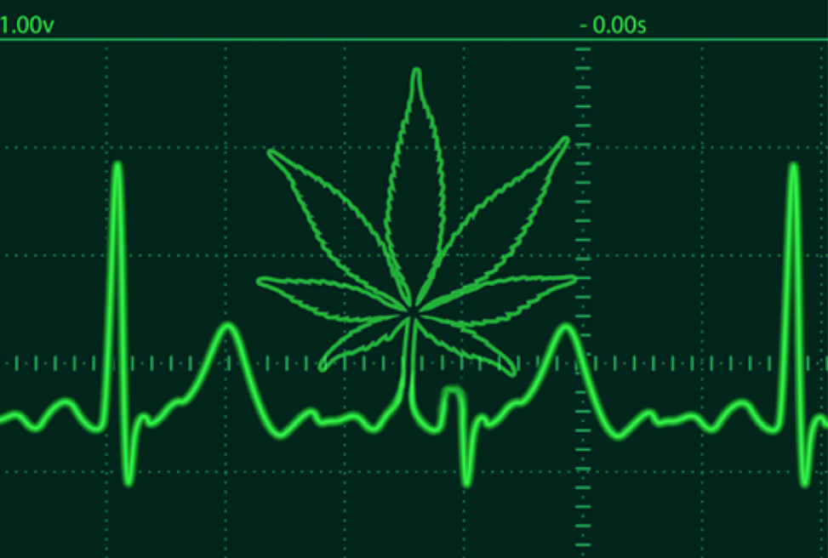
Common side effects of cannabinoids
Cardiovascular system
- Tachycardia
- Postural hypotension
- Palpitations
- Vasodilation (ﬂushing, red eyes)
- Increased risk of myocardial infarction
within one hour of use
Canadian Pain Society’s guidelines for the use of cannabinoid compounds in chronic pain; Pain Res Manag 2005

Slide 61
Common side effects of cannabinoids
Respiratory (if smoked)
Bronchitis/chronic obstructive pulmonary disease/lung infection
Other
Dry mouth
Headache
Abdominal pain
Cannabinoid hyperemesis syndrome
Canadian Pain Society’s guidelines for the use of cannabinoid compounds in chronic pain; Pain Res Manag 2005
Notes:
most common serious adverse events were abdominal pain (12%), intestinal obstruction (12%), and nephrolithiasis (12%).
- The most common non-serious adverse events were nervous system (20%), gastrointestinal (13.4%), and respiratory (12.6%) disorders

Slide 62
Practical considerations in medical cannabis administration and dosing; European Journal of Internal Medicine 49 (2018) 12–19

Slide 63
Anesthetic Consideration in a Cannabis Addict

Slide 64
Anesthetic Consideration in a Cannabis Addict
Marijuana cause cardiac arrhythmia, cardiac and respiratory depression , pulmonary edema
Compound of cannabinoid that compact anesthesia : delta 9 tetrahydrocannabinol and delta 8 tetrahydrocannabinol
Journal of the American Association of Nurse Anesthetists

Slide 65
Pharmacological activity of cannabinoids
Cannabidiol potentiates barbiturate sleeping time
- depends on amount of cannabis ingested
- factor alter metabolism or redistribution such as TCA , chronic
alcohol drinking
Anesthesiologist should consider the frequency of cannabis ,
time elapse
Cannabis and its effect on anesthesia ; Journal of the American Association of Nurse Anesthetists
Notes:
- TCA inhibit the metabolic transformation of THC in the liver 20-30%

Slide 66
The effects of THC to anesthesia
Cardiovascular system
Low dose increase sympathetic activity , decrease parasympathetic system
High dose depress the sympathetic system → hypotension
Cardiac depression by depress calcium dependent ATPase activity of cardiac muscle sarcoplasma
EKG : premature ventricular contraction (PVC), arrhythmia, invert T wave, decrease voltage of P wave, tachycardia, bradycardia
-Cannabis and its effect on anesthesia ; Journal of the American Association of Nurse Anesthetists
-Anesthetic Consideration in a Cannabis Addict; Journal of the College of Physicians and Surgeons Pakistan 2015, Vol. 25(Special Supplement 1): S2-S3
Notes:
Tachycardia : increase levels of epinephrine

Slide 67
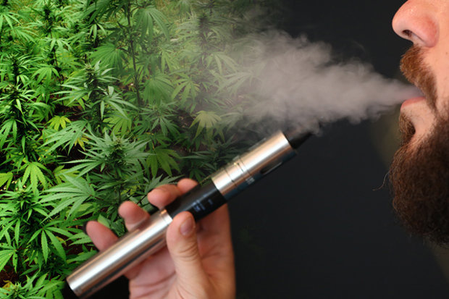
The effects of THC to anesthesia
Respiratory system
Cannabis smoking lead to chronic cough, airway irritation, wheezing
Upper airway edema, uvular edema
Pulmonary edema
Pulmonary depression
Heat regulating system
- Depress body’s temperature regulatory mechanism
Anesthetic Consideration in a Cannabis Addict; Journal of the College of Physicians and Surgeons Pakistan 2015, Vol. 25(Special Supplement 1): S2-S3
Notes:
- Some prophylactic dexa

Slide 68
Anesthetic considerations
Increase in sleeping time of barbiturate
Potentiation of nondepolarizing muscle relaxants by anticholinergic effects and deplete acetylcholine store
Potentiated norepinephrine effect
-Cannabis and its effect on anesthesia ; Journal of the American Association of Nurse Anesthetists
-Anesthetic Consideration in a Cannabis Addict; Journal of the College of Physicians and Surgeons Pakistan 2015, Vol. 25(Special Supplement 1): S2-S3
Notes:
Cannabinol increase level of epinephrine

Slide 69
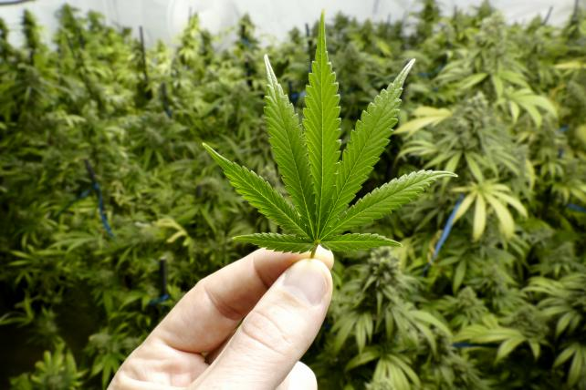
Anesthetic considerations
Augmentation effect of any drug which cause respiratory or cardiac depression
Inhalation anesthetics : addition of potent inhalational agents lead to further myocardial depression
Opioid : increase requirement
Notes:
Cannabinol increase level of serotonin in brain , Cannabinol is potent prostaglandin inhibitor
Potentiate barbiturate , prostaglandin inhibitor
addition of potent inhalational agents may lead to further myocardial depression.
inhalational anesthetics which sensitize the myocardium to the catecholamines may have a more profound response due to the increased level of epinephrine.

Slide 70
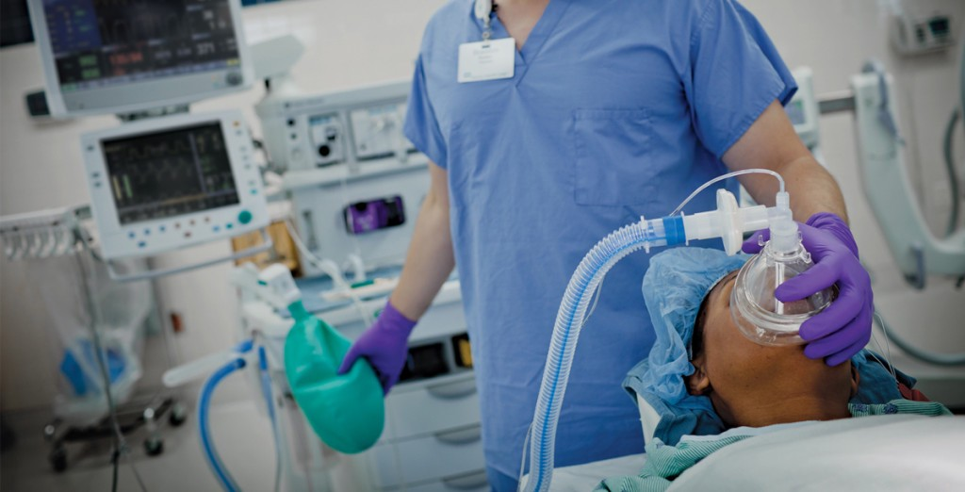
Anesthetic considerations
Should be avoid anesthesia in 72 hr in patient who used cannabis
If anesthesia unavoidable → reginal anesthesia is prefer
-Cannabis and its effect on anesthesia ; Journal of the American Association of Nurse Anesthetists
-Anesthetic Consideration in a Cannabis Addict; Journal of the College of Physicians and Surgeons Pakistan 2015, Vol. 25(Special Supplement 1): S2-S3

Slide 71
Take home messages

Slide 72
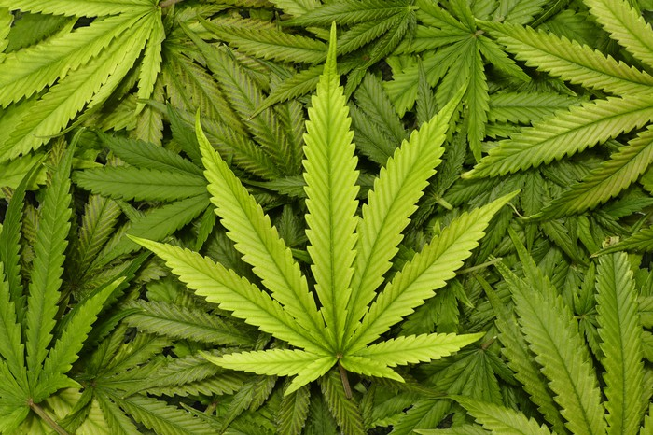
Take home messages
Cannabinoid receptor is lock and key system → activate presynaptic CB1 receptors, inhibit neurotransmitter release from the presynaptic neurons
Delta 9 THC is the most psychological effect in cannabis use

Slide 73
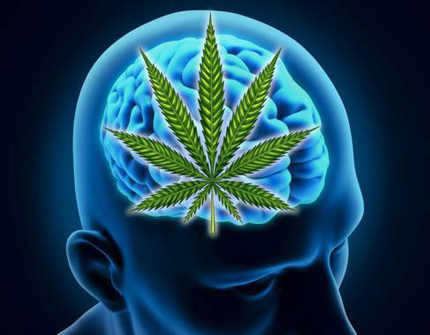
Efficacy of cannabis
- Nausea vomiting : reduce postoperative nausea vomiting with unacceptable side effect
- Appetite stimulant : treatment of acquired immune deficiency syndrome (AIDS)-related weight loss → evidence for the efficacy and safety is lacking

Slide 74
Cannabis and pain management
- Acute pain : administration of cannabinoids, associated with increased pain
- Chronic non-cancer pain : neuropathic pain, improvements in sleep, no serious adverse events reported
- Cancer-related pain : long-term beneﬁt, safety, and tolerability of oral THC and THC-CBD spray

Slide 75
Anesthetic Consideration in a Cannabis Addict
Potentiated barbiturate
Potentiated non depolarization muscle relaxant
Potentiated norepinephrine
Inhalation anesthetics have more profound response in myocardial sensitization, cardiac depression
Increase opioid use
Avoid anesthesia for 72 hr
Prefer reginal anesthesia

Slide 76
Thank you for your attention**

